Slide 1
Proportion Test

Slide 2
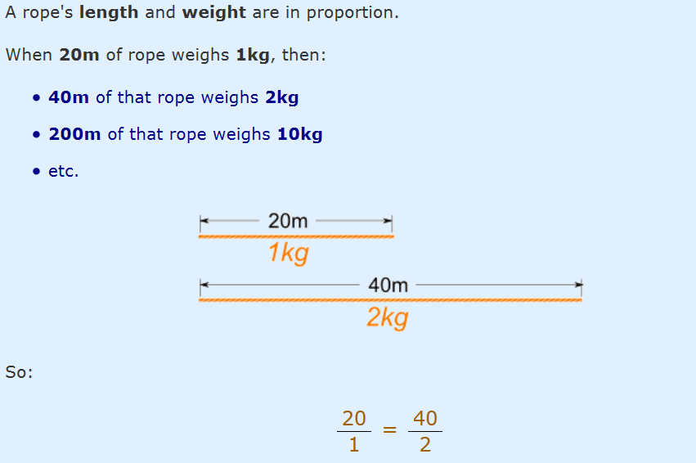

Proportion
Proportion says that two ratios (or fractions) are equal.
Notes:
https://www.mathsisfun.com/algebra/proportions.html

Slide 3
The CEO of a large electric utility claims that 80 percent of his 1,000,000 customers are very satisfied with the service they receive. To test this claim, the local newspaper surveyed 100 customers, using simple random sampling. Among the sampled customers, 73 percent say they are very satisified. Based on these findings, can we reject the CEO's hypothesis that 80% of the customers are very satisfied? Use a 0.05 level of significance.
 | # Satisfaction | # not satisfied
Observed( newspaper) | 100*.73 | 27
Expected | 100*.80 | 20
Notes:
https://stattrek.com/hypothesis-test/proportion.aspx

Slide 4

prop.test(x=73,n=100,p=0.83, alternative = "two.sided")
Chisq(x=c(73,27), p=c(0.80, 0.20))

Slide 5
The prop.test( ) command performs a two-sample test for proportions, and gives a confidence interval for the difference in proportions as part of the output.
The z-test comparing two proportions is equivalent to the chi-square test of independence, and the prop.test( ) procedure formally calculates the chi-square test.
The p-value from the z-test for two proportions is equal to the p-value from the chi-square test, and the z-statistic is equal to the square root of the chi-square statistic in this situation.
Notes:
http://sphweb.bumc.bu.edu/otlt/MPH-Modules/BS/R/R-Manual/R-Manual13.html

Slide 6
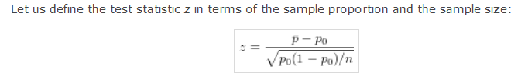
Hypothesis Test in Proportion

Slide 7
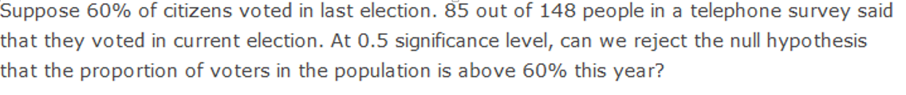
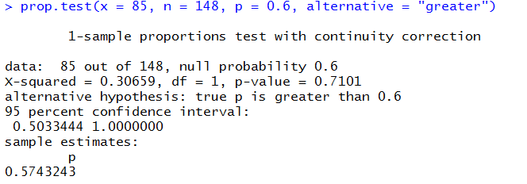
HA: P(voters)>60%
H0:P(voters)<= 60%
Notes:
http://www.r-tutor.com/elementary-statistics/hypothesis-testing/lower-tail-test-population-proportion

Slide 8
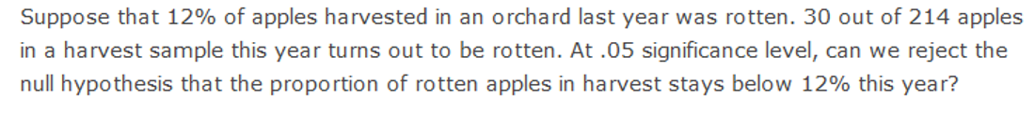
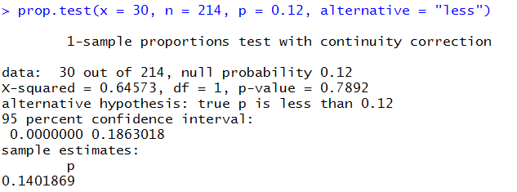
H0: P(Rotten apples)<= 0.12
HA: P(Rotten Apples)>0.12

Slide 9
